Slide 1
EU-METALIC Student Exchange ALGERIA-CROATIA Rania Chengane

Slide 2
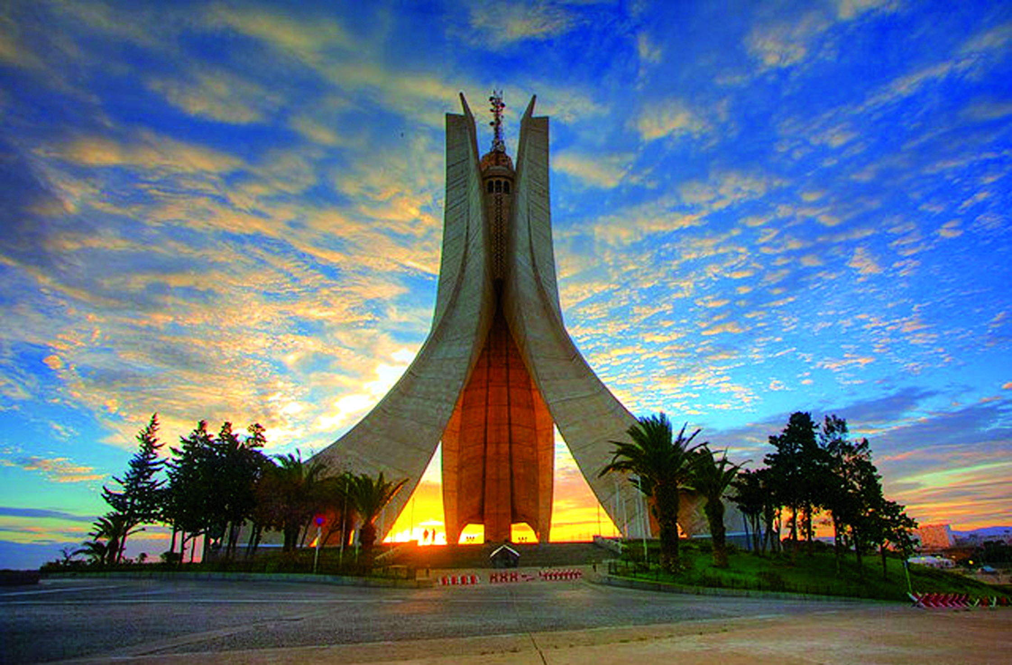
Hello!
I am Rania Chengane.
Algiers University 1
You can find me at: rania.chengane@gmail.com

Slide 3
Introduction:
Program :Erasmus Exchange program (EU-Metalic II).
Duration : 10 months (12 September 2016- 12 July 2017).
Country/City: Croatia/Zagreb.
Field of studies: Biology.

Slide 4
1.
Academic

Slide 5
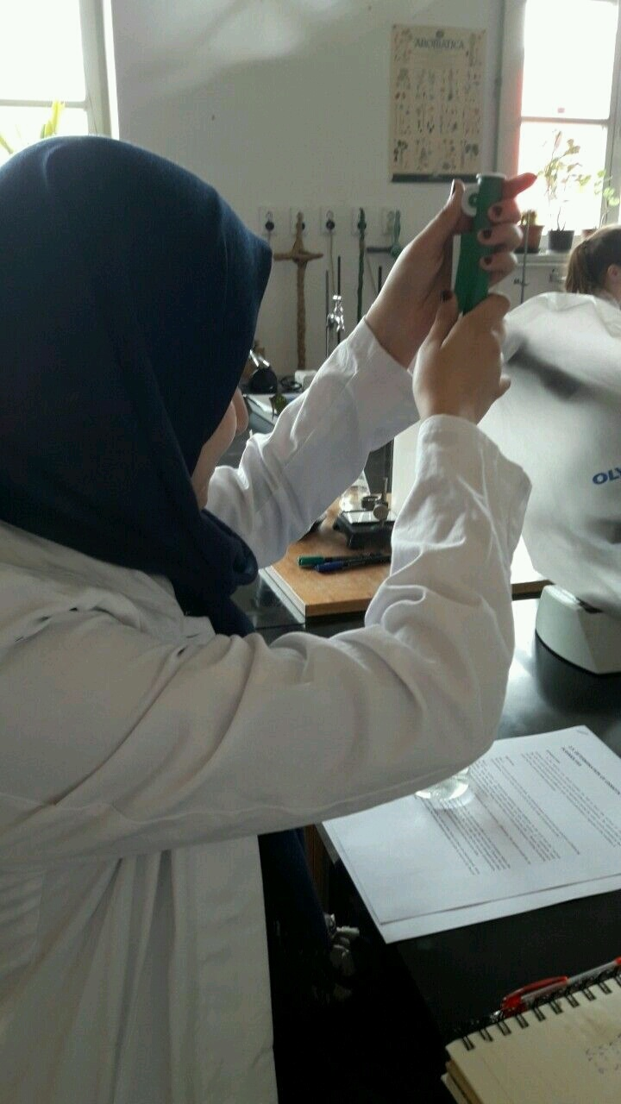
Biology courses:
First semester:
-Cells biology : (Credit 8)
-Biophysics : (Credit 5)
-Marine Biology : (Credit 4)

Slide 6
Second semester:
-Genetic: ( Credit 9)
-Plant physiology: (Credit 7)
-Model organisms in molecular biology: (Credit 4)
-Mediterranean: (Credit 3)

Slide 7
For the diffrent courses, I made presentations, seminar and reports.

Slide 8
2. Social

Slide 9
ESN Zagreb

Slide 10
ESN offers help in academic, social and practical integration process. This includes cultural and social events such as trips to various places within the country, film nights, buddy group and language projects; and international food fests

Slide 11
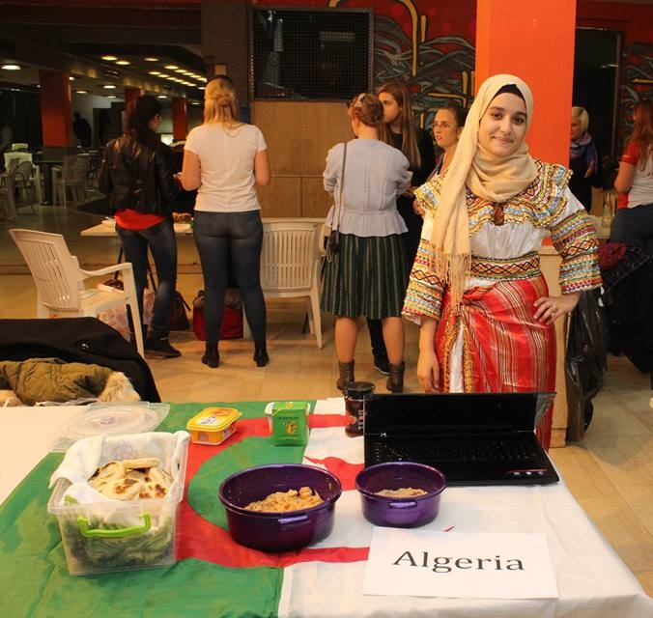
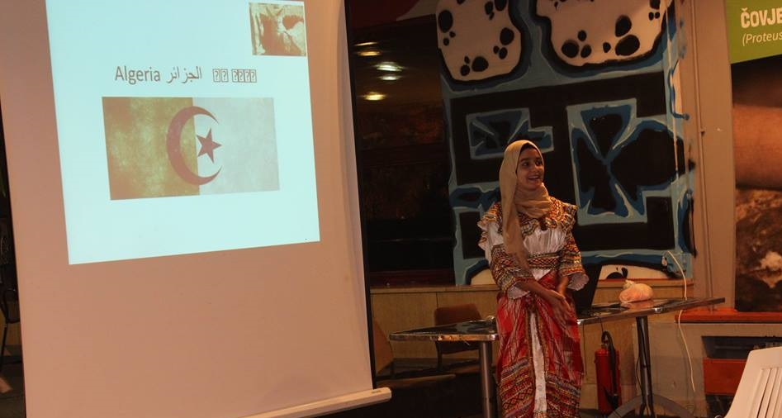
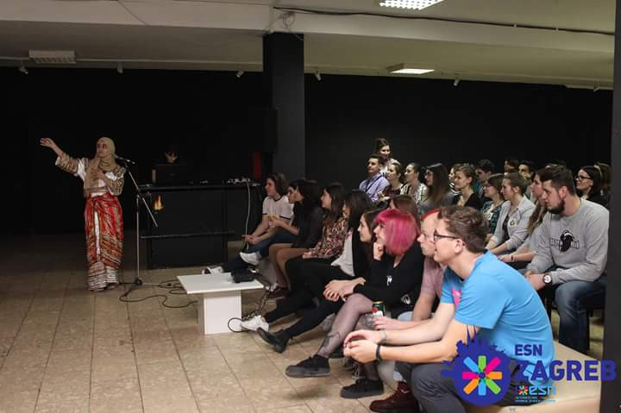
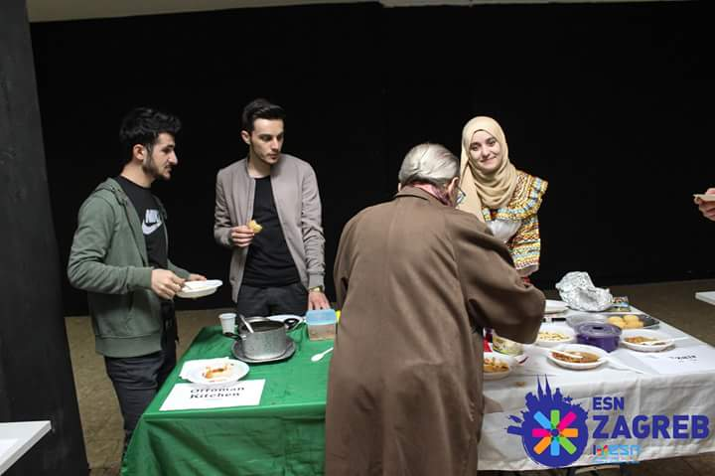
International dinner:

Slide 12
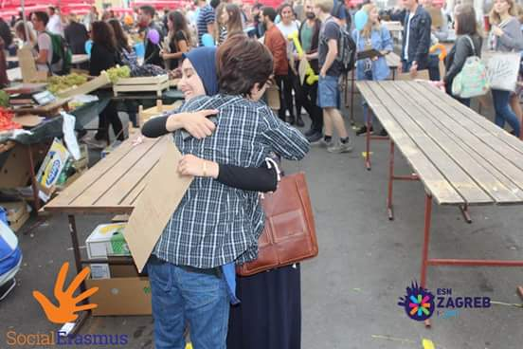
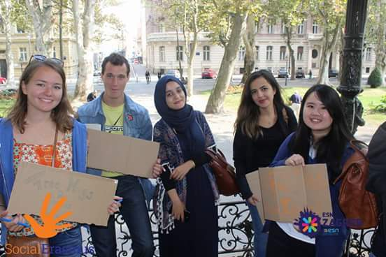
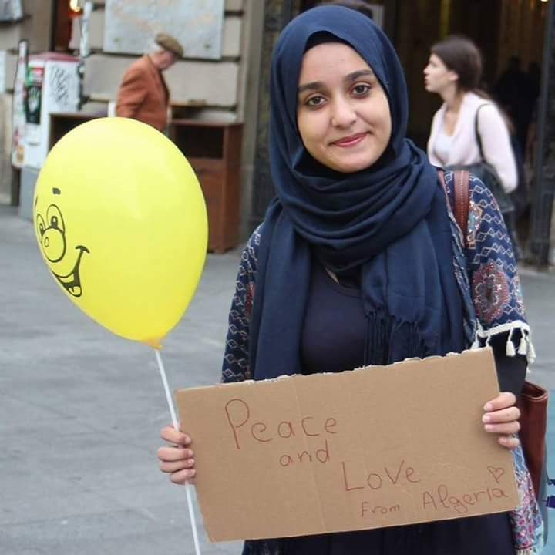
Free hugs :

Slide 13
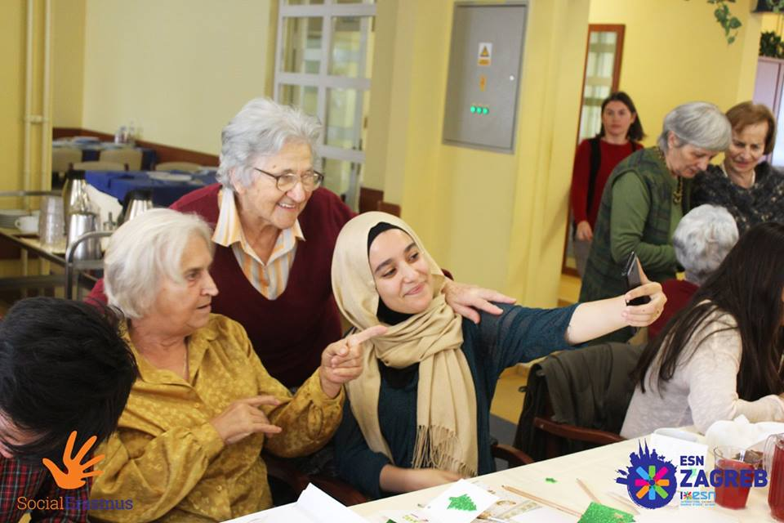
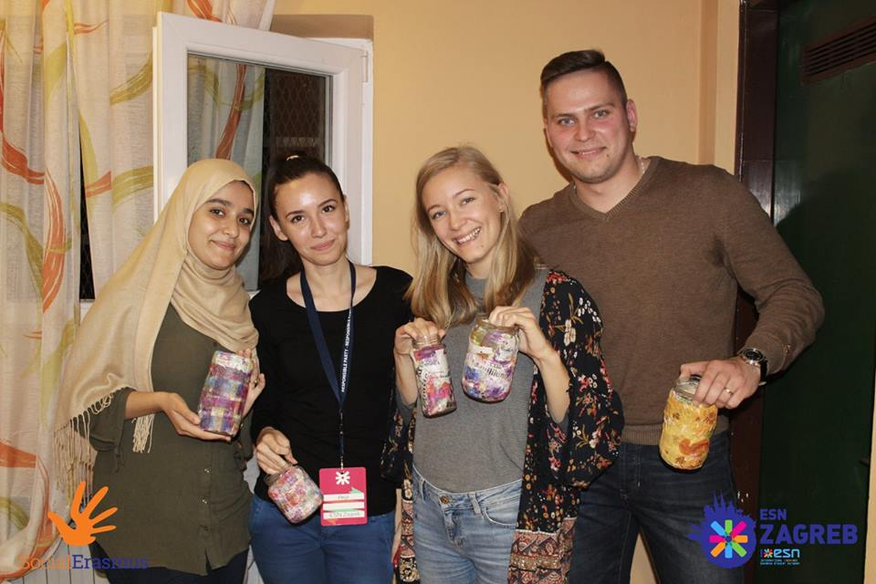
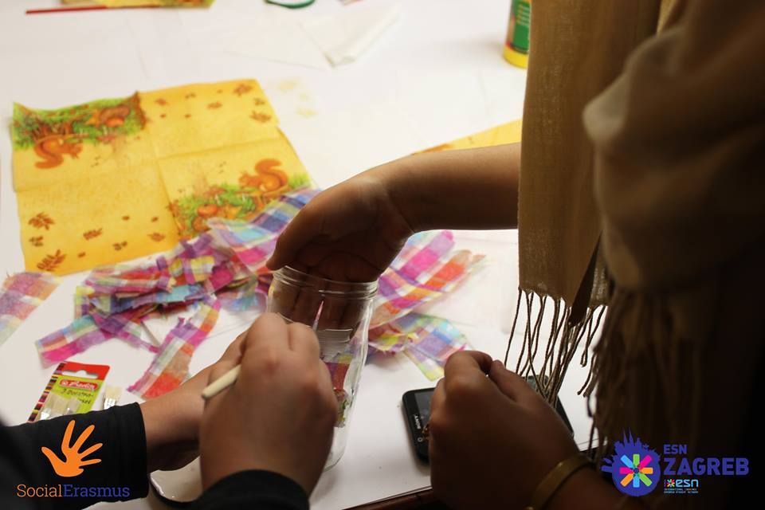
Social week

Slide 14
3. Volunteering

Slide 15
Are you syrious organisation:
Teaching Arabic for kids in a refugees center (Porin) with « Are you syrious »

Slide 16
Thanks!
Any questions?
You can find me at:
rania.chengane@gmail.com

